Slide 1
Chapter 11
Installing and Configuring Printers

Slide 2
Chapter 11 Objectives
Identify basic printer functions
Distinguish between classes of printers
Explain printer technologies
Explain the laser printing process
Install and manage printer drivers in Windows
View and install Windows fonts
Troubleshoot printer problems

Slide 3
Definition
Printers are electromechanical output devices that are used to put information from the computer onto paper

Slide 4
Basic Printing Functions
Receive data from the PC through an I/O interface
Store the data in printer RAM
Convert the data into print instructions
Feed the paper in and out
Store and dispense ink or toner
Transfer the image onto the paper

Slide 5
Line Printer
Print job is still spooling to the printer as the page begins printing
Requires very little RAM of its own
Examples: Ink-jet, dot matrix, daisywheel

Slide 6
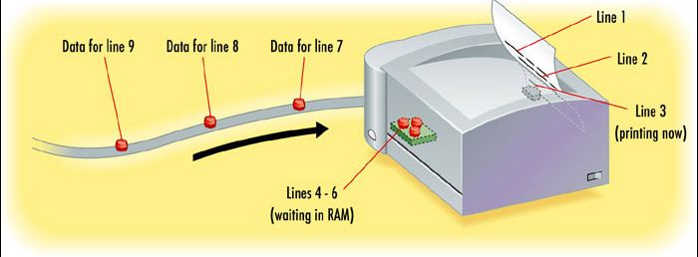
Line Printer

Slide 7
Page Printer
Entire page collects in printer RAM, then is transferred to the paper
Requires more RAM than a line printer because it must hold more data at a time
Examples: Laser, LED

Slide 8
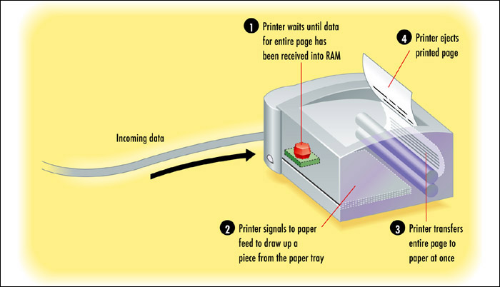
Page Printer

Slide 9
Ink or Toner
Liquid ink: Sprayed onto paper
Dry toner: Transferred to paper with electrical charge and then fused (melted) to the paper with heat
Inked ribbon: Pins or hammers strike the ribbon, leaving a mark on the paper behind it

Slide 10
Impact and Non-Impact
Impact printer strikes a ribbon physically. Only an impact printer is able to print on multi-part forms (such as carbon paper)
2 Types: Dot Matrix, Daisywheel
Non-impact printer does not use physical force to place the image on the page. Multiple copies must be printed individually.
Laser, inkjet, LED, thermal wax transfer
Notes:
Impact printer - The most basic type of printer
Use inked ribbon to make an imprint on paper
Disadvantage – poor image quality

Slide 11
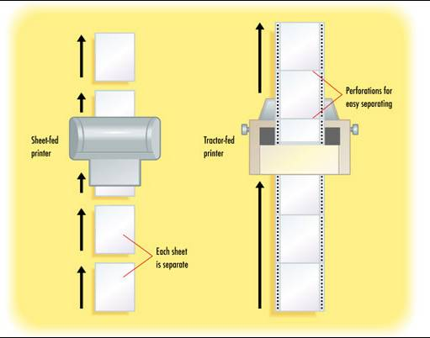
Paper Feed Type
Tractor-fed (continuous)
Sheet-fed or Paper-Feed
Notes:
Impact printers also use a paper feed mechanism called a tractor feed that requires special paper.
Perhaps you’ve seen it before—it’s continuous feed paper with holes running down both edges
The paper-feed Mechanism picks up paper from the paper drawer and feeds it into the printer.

Slide 12
Factors for Evaluating Printers
Initial cost
Total Cost To Own (TCO)
Cost of supplies
Ink, toner, special paper
Speed
Delay before printing starts
Pages per minute

Slide 13
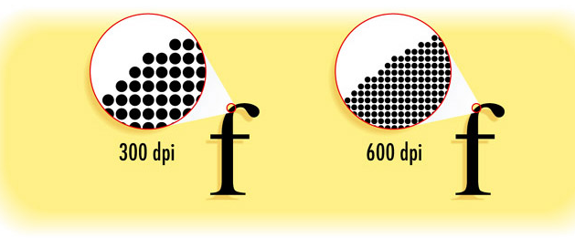
Factors for Evaluating Printers
Print quality
Measured in dots per inch (dpi)
Notes:
The higher the DPI the better the image quality

Slide 14
Factors for Evaluating Printers
Interface
Parallel, USB, network
Paper tray
Number of sheets of input, output
Paper feed type (tractor-fed, sheet-fed)
Extra RAM

Slide 15
Types of Printer Technology
Daisywheel (obsolete)
Dot Matrix
Inkjet
Laser
Thermal
Virtual

Slide 16
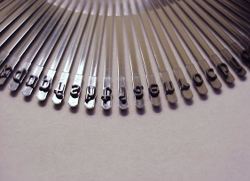
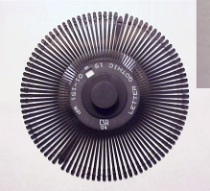
Daisywheel
Earliest type of printer, now long obsolete
Rotating wheel containing all the characters for a font
Tractor-fed
Impact
Inked ribbon
Single-color
Line printer

Slide 17
How Daisy Wheel works
Notes:
To print a character the printer sends a signal to the mechanism containing the wheel known as the Printhead
The printhead rotates the daisy wheel to position the character
Then a print hammer (Solenoid) strikes the back of the petal containing the character against a print ribbon making an impression on paper

Slide 18
How Daisy Wheel works
Notes:
Speed was measured in Characters per second (CPS)
2-4 characters per second max speed (poor)
Noisy – required special enclosure
Poor quality referred to as Letter Quality (LQ)

Slide 19
Dot Matrix
Improved on daisywheel by making multiple fonts possible
Letters formed by metal pins
Inked ribbon
Tractor-fed
Impact
Single-color
Line printer
Notes:
They work in a manner similar to daisy-wheel printers, but instead of a spinning, character-imprinted wheel, the print head contains a row of pins (short, sturdy stalks of hard wire).
These pins are triggered in patterns that form letters and numbers as the print head moves across the paper

Slide 20
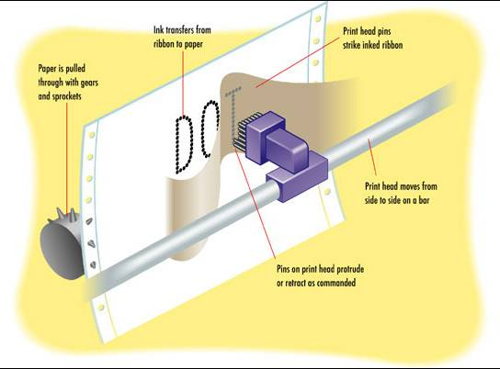
Dot Matrix
Notes:
Paper is pulled through gears aka impact paper
The output quality of such printers is referred to as draft quality—good mainly for providing your initial text to a correspondent or reviser.
Each letter looked fuzzy because the dots were spaced as far as they could be and still be perceived as a letter or image.
17-pin and 24-pin models were eventually developed increasing the quality (Near Line Quality – NLQ)

Slide 21
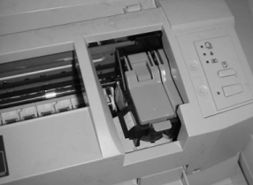
Inkjet
Liquid ink dispensed by nozzles in the print head
Aka Bubble jet
Sheet-fed
Non-impact
Multi-color
Line printer
Notes:
spray ink on the page to form the image
bubble-jet printer, droplets of ink are sprayed onto a page and form patterns that resemble the items being printed

Slide 22
Parts of an Inkjet Printer
Print head/ink cartridge
Head carriage, belt, and stepper motor
Paper-feed mechanism
Control, interface, and power circuitry
Notes:
Inkjet printers contain fewer parts than dot-matrix

Slide 23
Print Head Cartridge
Notes:
Print Head/ink Cartridge – spray the ink in small droplets onto the page.
Many times, the print head is part of the ink cartridge, which contains a reservoir of ink and the print head in a removable package.
Include colors CYMK (cyan, magenta, yellow, black)
When done printing the head moves to a Maintenance Station (usually on one end and contains small suction pump and ink-absorbing pad)
i.e. print head is parked (locked into rest position)

Slide 24
Stepper Motor
Notes:
The stepper motor and belt make the print head carriage move

Slide 25
Stabilizer Bar
Pulley
Stabilizer bar
Belt
Notes:
To keep the print head carriage aligned and stable while it traverses the page, the carriage rests on a small metal stabilizer bar
carriage belt, is driven by the carriage motor and moves the print head back and forth across the page while it prints
The print head carriage is the component of an inkjet printer that moves back and forth during printing.

Slide 26
Paper Feed Mechanism
Pick up Rollers
Separator Pads
Notes:
The paper-feed Mechanism picks up paper from the paper drawer and feeds it into the printer
First are the pickup rollers, which are several rubber rollers with a slightly flat spot; they rub against the paper as they rotate and feed the paper into the printer
separator pads - help keep the rest of the paper in place so that only one sheet goes into the printer

Slide 27
Inkjet Paper Tray
Notes:
Holds less paper than LaserJet trays

Slide 28
Paper-Feed Sensor
Notes:
These components tell the printer when it is out of paper as well as when a paper jam has occurred during the paper-feed process.

Slide 29
Control, Interface and Power Circuitry
Printer Control Circuits
Power Circuits
Notes:
The printer control circuits are usually on a small circuit board that contains
all of the circuitry to run the stepper motors the way the printer needs them to work
(back and forth, load paper and then stop, and so on).
Power Circuits - Convert power from AC to DC usually 12V and 5V. Accomplished using a Transformer

Slide 30
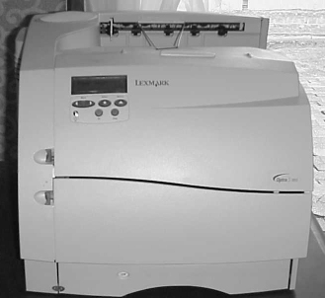
Laser
Solid toner dispensed by electrical charges
Sheet-fed
Non-impact
Single-color or multi-color
Page printer
Notes:
toner cartridge – holds toner (Black carbon substance mixed with polyester resins (to flow better) and iron oxide (to make it sensitive to light)
There are two major types of page printers that use the Electrophotographic (EP) print process:
The first uses a laser to scan the image onto a photosensitive drum, and the second uses an array of light-emitting diodes (LEDs) to create the image on the drum.
Even though they write the image in different ways, both types still follow the EP print process.

Slide 31
Toner Cartridge
Electrophotographic Cartridge EP

Slide 32
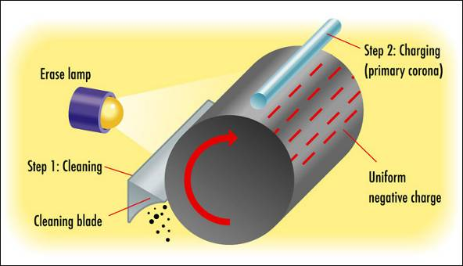
Laser Printing Process
Step 1: Processing
Step 2: Charging (Conditioning)
Notes:
Step 1 –has 2 steps - receives the image and creates the image. Computer sends the print job via USB, wire, wireless and printer creates the print job producing an output.
Laser printers print a horizontal strip at a time (same concept as dot-matrix) known as Scan-line or Raster line
Raster Image Processor – Component that manages raster creation

Slide 33
Laser Printing Process (Paul Can Walk, Dance & Talk French Clearly)
Step 1: Processing
Step 2: Charging (Conditioning)
Notes:
Step 2 – Wire or roller called (charging corona) uses high voltage to apply high negative charge to the surface of the photosensitive drum
The charge is -600VDC

Slide 34
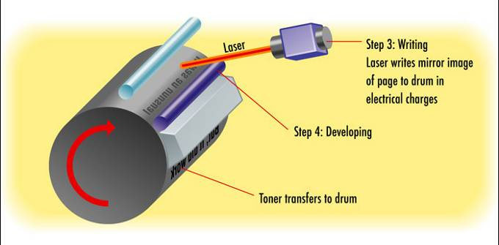
Laser Printing Process
Step 3: Writing
Step 4: Developing
Notes:
Step 3 – Exposes the drum to the image by turning on the laser which scans the drum
A pattern of the exposed area is formed representing the image
Step 4 – In this step, toner is transferred to the areas that were exposed in the writing step. A metallic developing roller inside the cartridge acquires charge which attracts toner. The roller continues to roll until the developed image is ready to be transferred

Slide 35
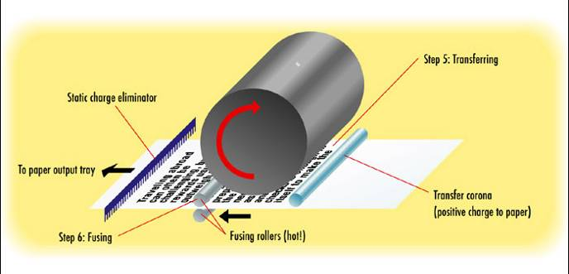
Laser Printing Process
Step 5: Transferring
Step 6: Fusing
Step 7: Cleaning
Notes:
Step 5 - The controller notifies the registration rollers that the paper should be fed through to begin the Transferring step. Corona applies positive charge to the paper (+600VDC) which can now pull toner from the photosensitive drum because paper and toner have opposite charge
Static eliminator strip – removes all charge from the paper; this keeps paper from attracting itself to the toner cartridge and causing a paper jam
**At this point toner is held in place by gravity and weak electrostatic charge
Step 6 – Toner image is made permanent. Fuser @ 350degF melts the polyester resin into the paper (i.e. fused)
Step 7 – A rubber blade inside the cartridge scrapes any toner left on the drum to a used toner receptacle inside the cartridge and a fluorescent lamp discharges any remaining charge. ** Drum is photosensitive to light thus loses all charge when exposed to light

Slide 36
Summary….

Slide 37
Summary of Printing Process
Page 523
**** Remember the voltages***:
–600VDC charge on the drum
–600VDC charge on the toner
+600VDC corona wire discharge (transfers toner from drum to paper)
-100VDC – laser paints image on drum & image areas are lowered to -100VDC

Slide 38
Summary of Types
 | Dot Matrix | Inkjet | Laser
Ink | Ribbon | Liquid | Toner
Paper feed | Tractor-fed | Sheet-fed | Sheet-fed
Line or Page | Line | Line | Page
Impact or Non-Impact | Impact | Non-impact | Non-impact
Color | No | Yes | Some

Slide 39
Thermal Printers
Used in Point-Of-Sale terminals and old faxes
Notes:
Type 1 – uses special waxy paper (i.e. heat sensitive paper). When it needs to print, a heating element heats certain spots on the print head. The paper below the heated print head turns black in those spots. As the paper moves through the printer, the pattern of blackened spots forms an image on the page of what is being printed
Another type - uses a heat-sensitive ribbon instead of heat-sensitive paper. A thermal print head melts wax-based ink from the ribbon onto the paper. These are called thermal transfer or thermal wax-transfer printers.

Slide 40
Virtual Printing
Sends the desired output to a file instead of to paper.
Click check box (click to file), or Select PDF, Document Writer etc
Notes:
There are four potential options for printing to a virtual printer: print to file, print to image, print to PDF, and print to XPS.

Slide 41
Printer Interfaces
Serial
Legacy Parallel
USB
Ethernet
Wireless
Notes:
A printer’s interface is the collection of hardware (port) and software (drivers) that allows the printer to communicate with a computer
Serial ports – Send 1 bit at a time. Old RS-232 were slow but newer fire-wire, thunderbolt, USB are more viable than parallel
Parallel – 8 bits at a time over 8 wires (1 for each bit) thus faster than serial. Uncommon today, replaced by USB and Ethernet
USB – Most popular. Higher transfer rates than older serial and parallel. Also PnP
Ethernet - These printers have an internal network interface card (NIC) that allow them to communicate on the network
Wireless – includes 802.11 standards (a,b,g,n, ac) and Bluetooth (short range wirless i.e. 10m or 3ft)

Slide 42
Printer Drivers
Page Description Languages (PDLs) translate between PC and printer
Popular PDLs include:
Printer Command Language (PCL), developed by HP for laser printers
PostScript, developed by Adobe for professional typesetting
Graphics Device Interface (GDI) – Monitors and Printers
Notes:
PDL - It describes the whole page being printed by sending commands that describe the text as well as the margins and other settings.
PCL –is the de-facto language
The PostScript printer driver describes the page in terms of “draw” and “position” commands – more or less in English
GDI - it’s a series of components that govern how images are presented to both monitors and printers.
GDI printers work by using computer processing power instead of their own. The printed image is rendered to a bitmap on the computer and then sent to the printer.

Slide 43
Installing a Printer Driver in Windows
Windows refers to a driver as a “printer”
You can have more than one driver installed for the same printer, resulting in multiple “printers” in Windows for a single physical unit

Slide 44
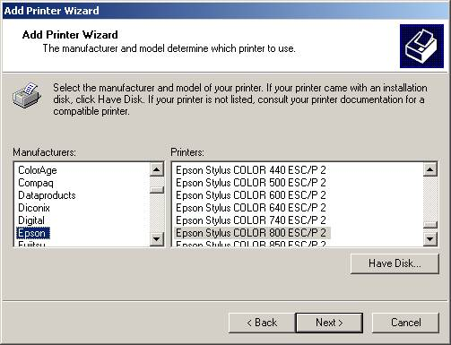
Installing a Printer Driver in Windows
Run the Add Printer Wizard
Let Windows detect the printer, or
Choose from a list

Slide 45
Installing and Sharing Local Printers
1. Attach the device using a local port (USB, parallel) and connect the power.
2. Install and update the device driver and calibrate the device.
3. Configure options and settings.
4. Print a test page.
5. Verify compatibility with the operating system and applications.
6. Educate users about basic functionality.
Notes:
Disadvantages:
All users who need to print to your device may need local accounts on your computer
Your computer is the print server (device that hosts the printer and processes the necessary printer commands). This can slow your system down
If your computer is turned off – no one can print

Slide 46
Installing and Sharing Network Printers
Integrated print server vs
Separate hardware print server
if a printer is capable of connecting directly to a network, it has the ability to be its own print server
Notes:
There are two major varieties of print servers that you will find. The first is incorporated into the printer itself (called an integrated print server), and the second is
a separate hardware print server

Slide 47
Installing and Sharing Network Printers
1. Connect the printer to the network and power it on.
2. Configure the printer with an IP address if it does not already have one.
3. From your Windows 7 computer, start Add A Printer.
4. Choose Add A Network, Wireless, Or Bluetooth Printer and click Next.

Slide 48
Installing and Sharing Network Printers
5. On the next screen, the system will search for printers. You can let it search, or you can stop it and click the link that says “The Printer That I Want Isn’t Listed.”
6. Choose Add A Printer Using A TCP/IP Address Or Hostname and click Next.

Slide 49
Installing and Sharing Network Printers
7. Enter the IP address (or hostname) of the printer that you want to add, add a port
name (it’s just for identification), and click Next.
8. Select the make and model of your printer from the list.
9. You will be prompted to install the driver; continue installing the printer as you would any other local or networked printer.

Slide 50
Printer Driver Maintenance
Remove a Printer
Delete its icon from the Printers (or Printers and Faxes) folder
Set Default Printer
Right-click icon and choose Set as Default
View Driver Properties
Right-click icon and choose Properties

Slide 51
Apple’s Bonjour
Bonjour – was designed to enable automatic discovery of devices and services on local networks using TCP/IP
It discovers printers and devices on the LAN
It works with other Operating Systems
In Windows services.msc lists the services

Slide 52
Apple’s AirPrint
Bonjour cannot find systems on the other side of the router (works on Single Broadcast domain)
Airprint meets this need
Mobile devices can automatically detect
AirPrint-enabled printers on their local network and print to them without requiring the installation of a driver

Slide 53
Cloud Printing
Printing to a remote device, one that is not necessarily located on your local network
Requires a service such as such as Google Cloud Print, HP ePrint
Page 546 – Enabling cloud printing

Slide 54
Laser Printer Maintenance
Wipe out the inside
Run printer’s cleaning sequence
Adjust toner delivery
Change toner cartridge
Change cleaning pad
Clean corona wires
Replace drum
Notes:
Most printers have a self-cleaning utility that is activated through a menu option
But if you are having print-quality issues, you might want to consider purchasing a cleaning or maintenance
kit, which frequently comes with a cleaning solution

Slide 55
Inkjet Printer Maintenance
Change ink cartridges
Run printer’s cleaning sequence

Slide 56
Ensure Suitable environment
Heat
Humidity
Light
Ozone
Notes:
Heat Laser printers can generate a lot of heat - ensure that your laserprinter is in a well-ventilated area.
Humidity High humidity can cause printer paper to stick together. Sticky paper leads to paper jams.
Light. Exposing the drum to light could ruin the drum.
Ozone Laser printers that use corona wires produce ozone as a by-product of the printing
process. In offices, ozone can cause respiratory problems in small concentrations, and it can
be seriously dangerous to people in large amounts - laser printers don’t produce large amounts of ozone, and most laser printers have an ozone filter
Ammonia A printer doesn’t produce ammonia, but it is contained in many cleaning products.
Ammonia can greatly reduce the printer’s ability to neutralize ozone and can cause
permanent damage to toner cartridges. It’s best to avoid using ammonia-based cleaners
near laser printers.

Slide 57
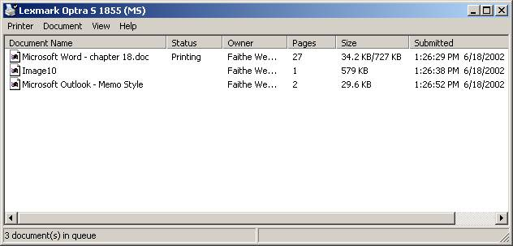
Print Queue
View print queue
Double-click printer icon in Printers folder

Slide 58
Managing a Print Queue
Pause print queue
Printer > Pause Printing
Clear print queue
Printer > Cancel All Documents
Pause an individual print job
Document > Pause
Cancel an individual print job
Document > Cancel, or press Delete

Slide 59
Troubleshooting Printing Problems
Stalled queue
Pause and resume queue after deleting job with error
Junk characters in printout
Power printer off
Clear queue
Power printer on and try again
If problem persists, reinstall driver

Slide 60
Troubleshooting Printing Problems
Paper jams
Fan paper before inserting in tray
Check feed rollers
Check for obstructions inside printer (ex. bits of paper)
Use different weight of paper

Slide 61
Troubleshooting Printing Problems
Illegal operation or general protection fault
Pause and resume print queue
Restart computer
Remove and reinstall printer driver

Slide 62
Laser Quality Problems
Printout faint in some spots
Shake toner cartridge gently
Replace toner cartridge
Loose or smeared toner
Check fuser
Vertical white streaks
Dirty corona wires

Slide 63
Inkjet Quality Problems
Stripes, or one color missing
Clean ink jets using printer’s utility
Run printer’s self-test
Colors off alignment
Run printer’s alignment utility

Slide 64
Printer Upgrades
Installing Printer Memory
Installing a Network Interface Card
Upgrading Printer Firmware
Other Upgrades:
Hard drives,
Trays and Feeders,
Finishers
Notes:
Memory
Purchase only memory that is compatible with your printer model. Most printers
today use a standard computer dual in-line memory module (DIMM), but check your
manual or the manufacturer’s website to be sure
NIC
The NIC in a printer is similar to the NIC in a computer, except
NIC in a printer has a small processor on it to perform the management
NIC in a printer is proprietary, for the most part. The same manufacturer makes the printerand the NIC.
Firmware:
Done by downloading and/or installing a free file from the manufacturer’s website
Reasons: If your have compatibility issues, or if you want to add new functionalities/features
Other
HDD - printer manufacturers made it possible for hard drives to be added to many printers. The hard drives can be used to
store many fonts used during the print process
Trays/Feeders – To increase capacity, add new paper types (envelope)
Finishers – They do the following: folding, stapling, hole punching, sorting, or collating the sets of documents
being printed into their final form

